Slide 1
Northeast Region Commercial Fishing Input-Output Model (NERIOM II)
Scott Steinback and Greg Ardini
Northeast Fisheries Science Center
2024 NOAA Fisheries Economics & Social Sciences Workshop
IO Model Developments
September 10, 2024

Slide 2
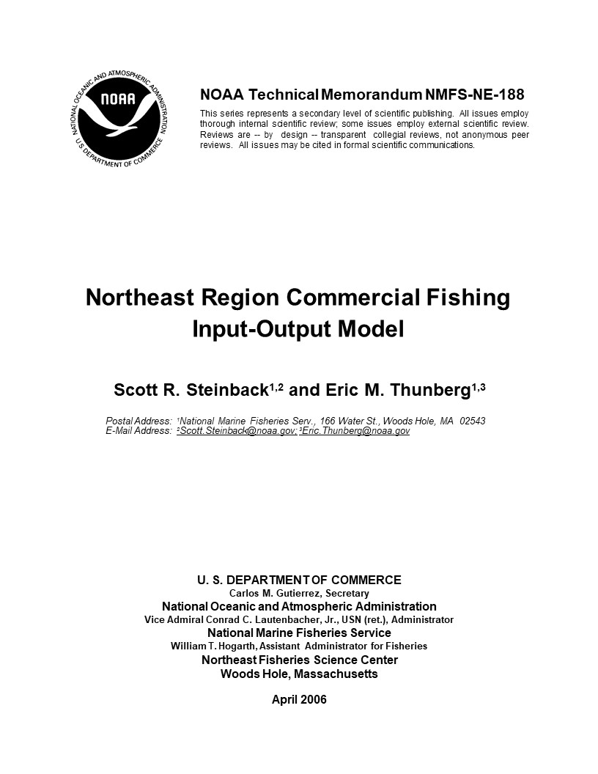
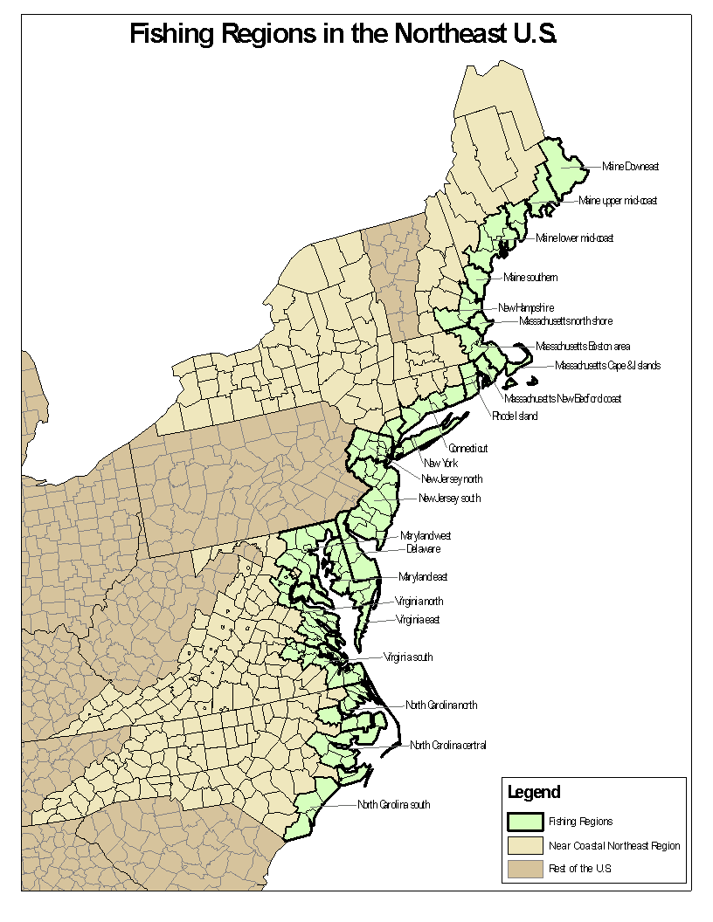
NERIOM I
Notes:
Created:
394 harvesting sectors (23 subregions * 18 gear sectors)
23 wholesale seafood dealer sectors (one in each subregion)
23 new seafood processing sectors
4 fish exchange sectors and 46 bait supplying sectors
Model consisted of 997 sectors (507 default IMPLAN sectors and 490 new sectors)

Slide 3
NERIOM I vs NERIOM II
NERIOM I
Internalized 490 subregional fishery-related sectors and therefore explicitly modeled (1) the inter-industry transactions between those sectors and (2) between the 490 fishery-related sectors and all the other default sectors in the model
NERIOM II (Approach used in FEAM, U.S. Minerals Management Service model, and FEUS)
Changes in ex-vessel revenues are allocated to IMPLAN sectors according to proportions contained in a production function and then these output values are multiplied by the IMPLAN-generated multipliers to estimate impacts
Model results are more aggregated and less flexible than NERIOM I, but much easier to construct/update/use

Slide 4
NERIOM II
A simplified I-O model that can be used for:
Economic contribution assessments
Economic impact assessments of fishery management actions in a timely manner
Linking to ecosystem models to calculate changes in economic indicators (e.g., jobs and income)

Slide 5
Model
Regulations target commercial harvesters and often specific species and gear sectors
Grouped harvesting activities into 19 distinct species/species groups and 13 gear sectors
Notes:
Disaggregated by size when possible.
Disproportionality: Examine impacts between large and small entities

Slide 6
Commercial Harvesting Species/Species Groups
1) Black sea bass
2) Bluefish
3) Groundfish
4) Herring
5) Jonah crab
6) Lobster
7) Mackerel
8) Monkfish
9) Other species
10) Red crab
11) Scup
12) Sea scallop
13) Skate
14) Spiny dogfish
15) Squid
16) Summer flounder
17) Surf clam/ocean quahog
18) Tilefish
19) Whiting

Slide 7
Commercial Harvesting Gear Groups
1) Gillnet large
2) Gillnet small
3) Handgear
4) Longline
5) Midwater trawl
6) Otter trawl large
7) Otter trawl small
8) Pot/trap large
9) Pot/trap small
10) Purse seine
11) Surf clam/ocean quahog dredge
12) Scallop dredge large
13) Scallop dredge small

Slide 8
Commercial Harvesting Data
Species-level revenue by gear is available through vessel and dealer trip reports
NOAA Fisheries observers collect trip-level cost data (fuel, oil, ice, supplies, food, bait)
Fixed cost data collected through periodic surveys of federally permitted commercial harvesters

Slide 9
Example Economic Impact Assessment
Reduction in Annual Catch Limit (ACL) for summer flounder expected to reduce commercial fishing harvesting revenue by $5 million in the Northeast Region next year

Slide 10
Assign Summer Flounder $5M Reduction to Commercial Harvesting Gear Groups

Slide 11
Assign Commercial Harvesting Expenses to IMPLAN Sectors

Slide 12
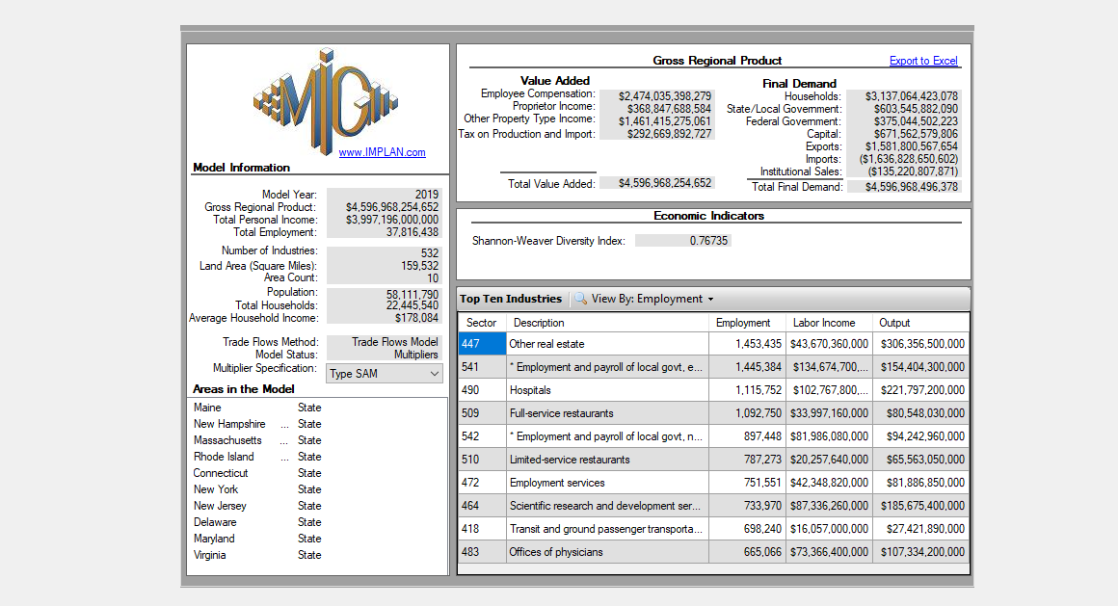
Step 1: Create Northeast Region IMPLAN Model

Slide 13
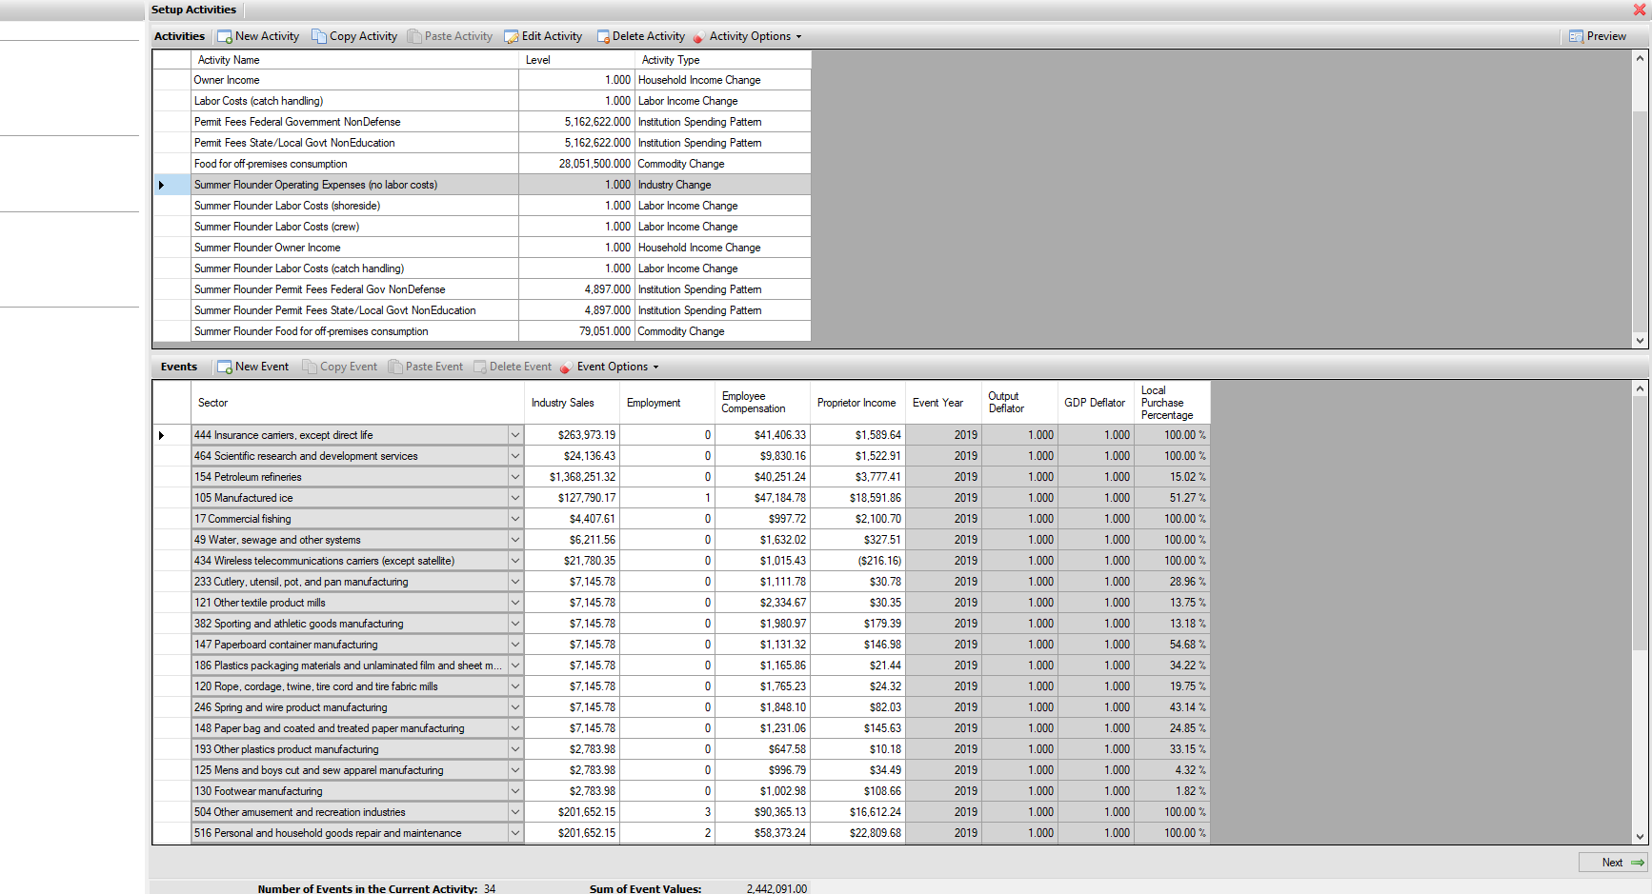
Step 2: Setup Activities/Events
Import Commercial Fishing Harvesting Expenses

Slide 14
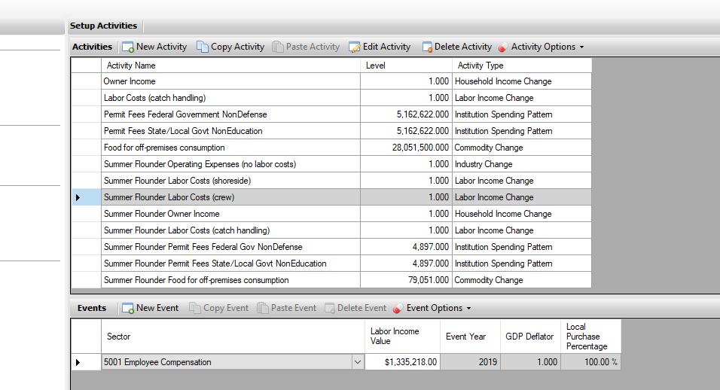
Step 2 Continued: Setup Activities/Events
Enter payments to crew

Slide 15
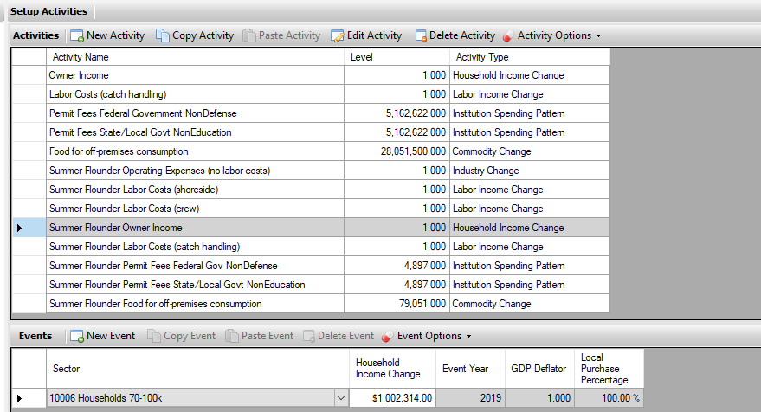
Step 2 Continued: Setup Activities/Events
Enter owner income

Slide 16
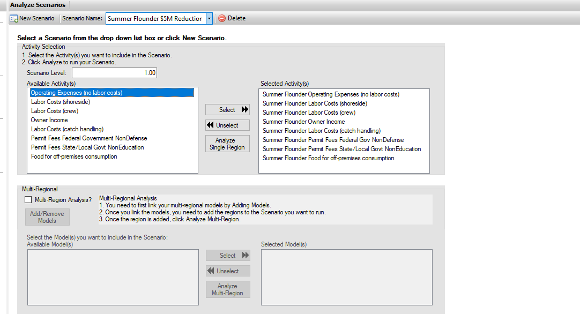
Step 3: Run the Scenario (economic impact of $5 million reduction in summer flounder landings)

Slide 17
Step 4: Output Economic Impact Results

Slide 18
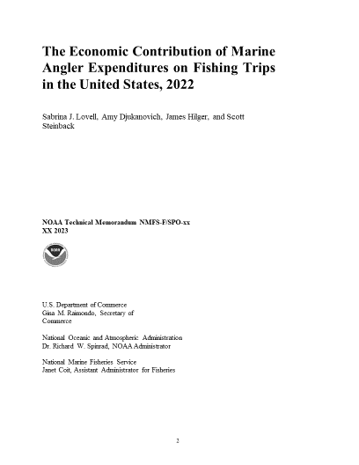
FEUS Recreational Model

